Slide 1
LGBTQ+ History Trivia
Notes:
2 + enter to return to score board
F5 starts show (Mac users: Command + Return)
Explain how show works and rules no googling.
Pick a person who is not the host to keep score.
In presentation mode, use the pen tool to mark which categories have been chosen.

Slide 2
Panel
Gay & lesbian trailblazers
LGBTQ+ activism & Action
Legal wins
Bisexual & Transgender Trailblazers
Representation
$200
$200
$200
$200
$200
$400
$400
$400
$400
$400
$600
$600
$600
$600
$600
$800
$800
$800
$800
$800
$1000
$1000
$1000
$1000
$1000
Notes:
In presentation mode, use the pen tool to mark which categories have been chosen.

Slide 3
Bayard Rustin, noted civil rights activist and gay man, was the chief organizer behind the historic March on Washington, which culminated with this Dr. Martin Luther King Jr.’s famous speech.
Gay & lesbian trailblazers· $200
Back to game board
Notes:
What is “I Have a Dream”?

Slide 4
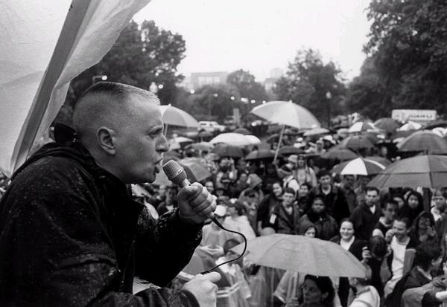
This queer, antiracist, Jewish, butch lesbian wrote "Stone Butch Blues" in 1992 about working-class butch and femme lives in Buffalo, NY. They also did activism work around disability, transgender rights, and communism.
Gay & lesbian trailblazers · $400
Back to game board
Notes:
Who is Leslie Feinberg?

Slide 5
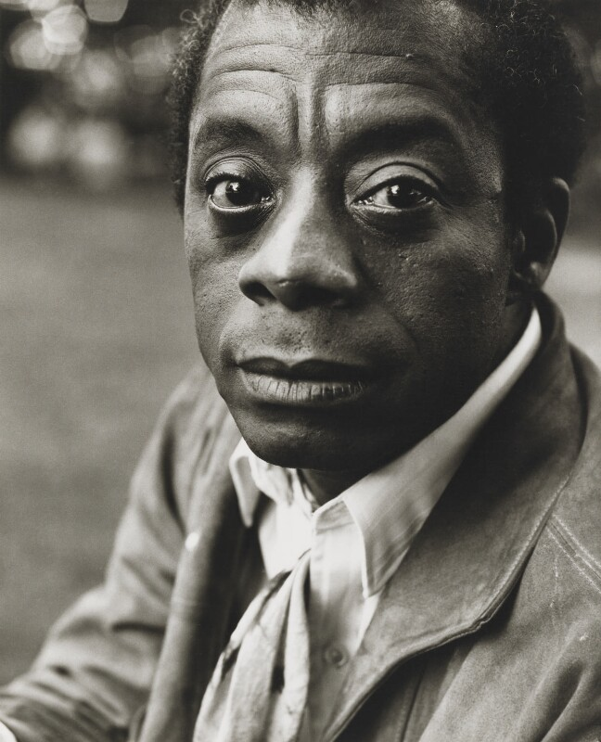
This famous writer, activist, and poet wrote "Giovanni's Room" in 1956 about an American man living in Paris having a love affair with an Italian bartender.
Gay & lesbian trailblazers · $600
Back to game board
Notes:
Who is James Baldwin?

Slide 6
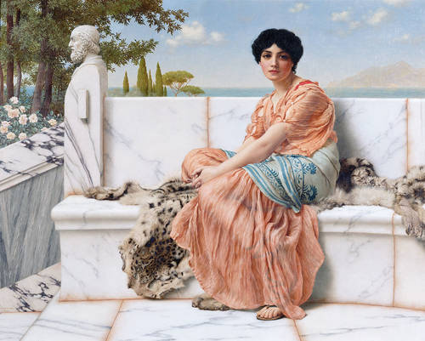
The Greek Poet, Sappho, born in 620 BC, wrote poetry about women loving women on this island.
Gay & lesbian trailblazers · $800
Back to game board
Notes:
What is the isle of Lesbos?
Note: The word lesbian is derived from this isle.

Slide 7
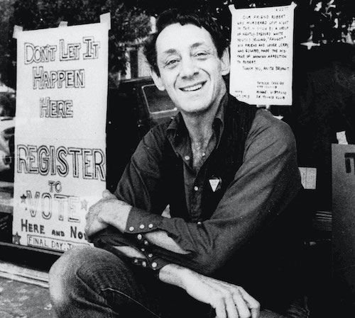
This man was the first openly gay politician in California.
Gay & lesbian trailblazers · $1000
Back to game board
Notes:
Who is Harvey Milk?

Slide 8
The Stonewall Riots are considered the start of the LGBTQ+ movement. It is named after this place
LGBTQ+ activism & Action· $200
Back to game board
Notes:
What is The Stonewall Inn?

Slide 9
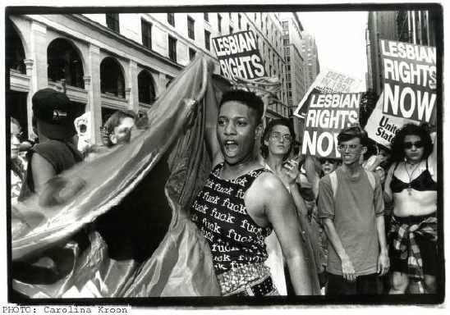
The Lesbian Avengers began this march to celebrate dyke visibility and awesomeness.
LGBTQ+ activism & Action · $400
Back to game board
Notes:
What is The Stonewall Inn?

Slide 10
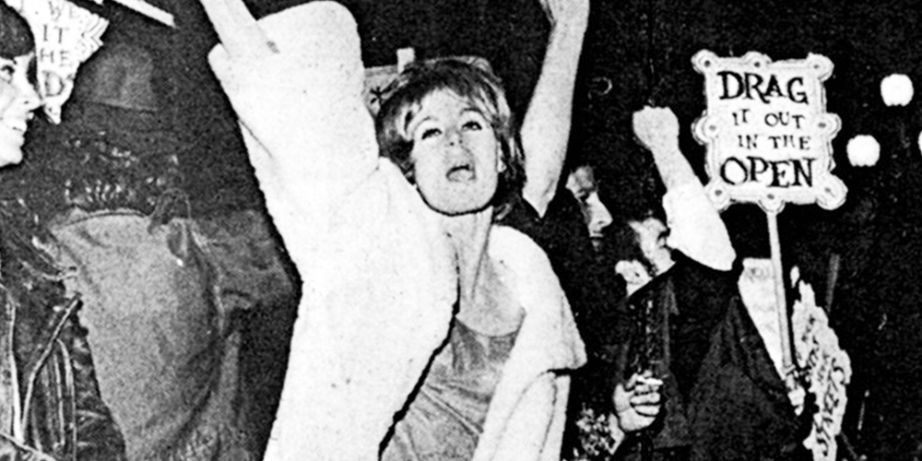
Tired of being harassed by police at the all-night diner in Compton, California, transgender women fought back in 1966 at this uprising.
LGBTQ+ activism & Action · $600
Back to game board
Notes:
What are the Compton's Cafeteria Riots?

Slide 11
Transgender folks, tired of being harassed by police, started an uprising in a downtown LA 24-hour doughnut shop in May 1959 by throwing doughnuts, coffee, and paper plates at the officers.
LGBTQ+ activism & Action · $800
Back to game board
Notes:
What is the Cooper's Do-nuts Riot?

Slide 12
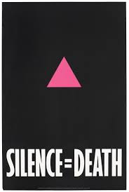
This direct-action activist group, was founded in the LGBT Community Center in New York City to bring attention to HIV/AIDS – related issues using civil disobedience.
LGBTQ+ activism & Action · $1000
Back to game board
Notes:
What is ACT-UP? (AIDS Coalition to Unleash Power)

Slide 13
In 2015, the Supreme Court of the United States voted that the constitution allows same-sex couples to do this.
Legal wins· $200
Back to game board
Notes:
What is get legally married?

Slide 14
The board of the American Psychiatric Association removed this diagnosis for same sex attraction from its official list of psychiatric disorders, the DSM-II in 1973.
Legal wins · $400
Back to game board
Notes:
What is “Homosexuality”?
Note: The resolution also urged an end to private and public discrimination and repeal of laws discriminating against people with same-sex attraction.

Slide 15
The Supreme Court of the United States decided the LGBTQ+ people are protected in the workplace in this year.
Legal wins · $600
Back to game board
Notes:
When is 2020?

Slide 16
It was illegal to have consensual same-sex sexual relations in New Mexico until this decade.
Legal wins · $800
Back to game board
Notes:
What is 1970’s?
(1975, exactly)
Note: NM was one of the first states to repeal sodomy laws.

Slide 17
This US military policy officially ended in 2011. It allowed LGB people to serve openly in the military, but it did not lift regulations barring many transgender people from serving.
Legal wins · $1000
Back to game board
Notes:
What is “Don’t Ask Don’t Tell”?

Slide 18
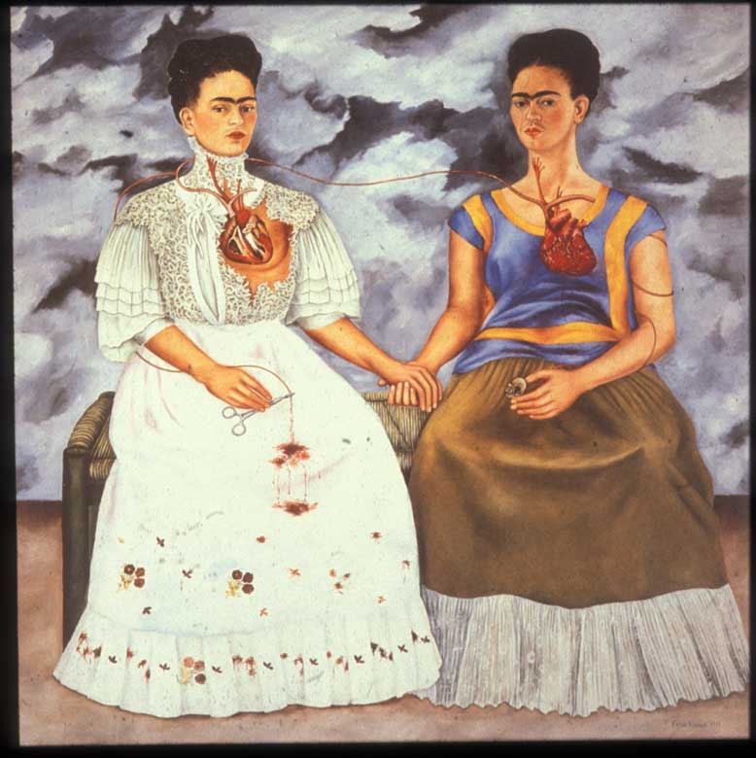
This bisexual artist explored issues of gender, illness, Mexican identity, and politics.
Bisexual & Transgender Trailblazers· $200
Back to game board
Notes:
Who is Frida Kahlo?

Slide 19
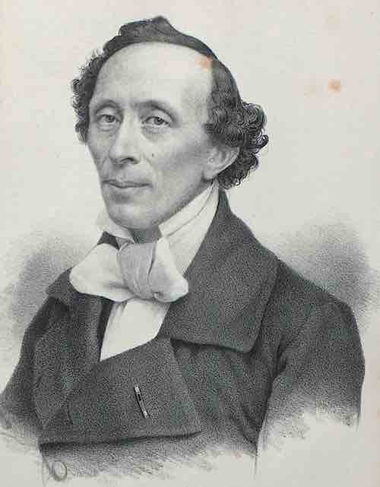
This Danish author wrote "The Emperor's New Clothes", "The Little Mermaid", "The Snow Queen", "The Ugly Duckling", and many other children's stories was also bisexual.
Bisexual & Transgender Trailblazers · $400
Back to game board
Notes:
Who is Hans Christian Andersen?

Slide 20
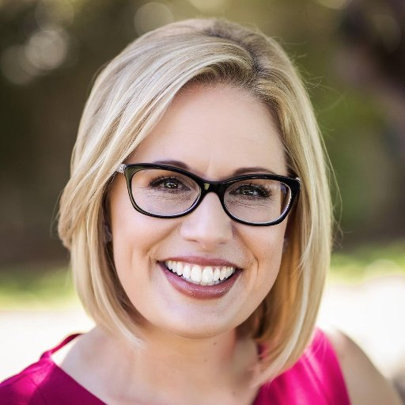
Kyrsten Sinema became the first openly bisexual person elected to US congress in 2012 from this state.
Bisexual & Transgender Trailblazers · $600
Back to game board
Notes:
What is Arizona?

Slide 21
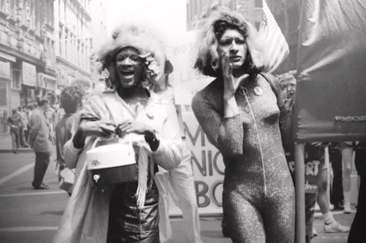
These pioneering transgender activists who worked on behalf of homeless LGBTQ youth and those affected by HIV/AIDS. They were two key figures in the Stonewall Uprising.
CATEGORY 4 · $800
Back to game board
Notes:
Who are Marsha P. Johnson and Sylvia Rivera?

Slide 22
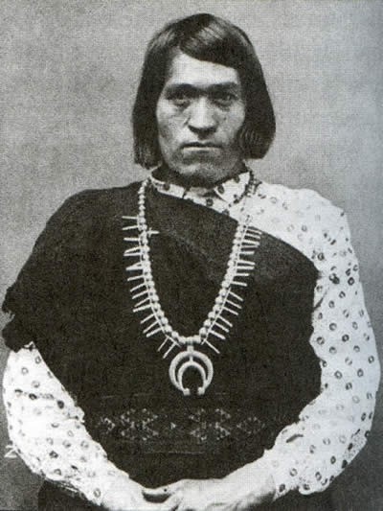
We’wha was an accomplished weaver, potter, and the most famous Ihamana, a traditional native gender role now described as mixed-gender or Two-Spirit. They were from this New Mexican Pueblo.
Bisexual & Transgender Trailblazers · $1000
Back to game board
Notes:
What is Zuni Pueblo?

Slide 23
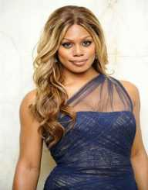
She is the first openly transgender person to be on the cover of Time magazine. She played Sophia Burset on Orange is the New Black.
Representation· $200
Back to game board
Notes:
Who is Laverne Cox?

Slide 24
Bisexuals make up this percentage of the LGB population in the US.
Representation· $400
Back to game board
Notes:
What is 52%?
(answers within 5% count for correct)
Source: UCLA Williams institute, https://williamsinstitute.law.ucla.edu/ publications/how-many-people-lgbt/

Slide 25
3.4% of high schoolers in New Mexico identify as this.
Representation · $600
Back to game board
Notes:
What is transgender, genderqueer, or genderfluid?
(must get at least one to be correct)
Source: NM YRSS 2017 YRRS data 2017

Slide 26
Pedro Pablo Zamora was one of the first openly gay men who was HIV positive to be portrayed in popular media, Zamora brought international attention to HIV/AIDS and LGBTQ issues and prejudices through his appearance on this reality TV Series in 1994.
Representation · $800
Back to game board
Notes:
What is MTV's Real World: San Francisco?

Slide 27
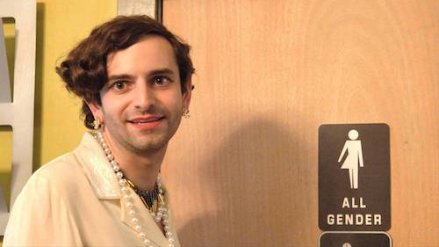
This MTV series aired an episode in 2015 covering the topic of living and being genderqueer, bringing to light for many viewers at home how to properly use the singular “they” pronoun.
Representation · $1000
Back to game board
Notes:
What is MTV series "True Life"?

Slide 28
The original rainbow flag, designed by artist Gilbert Baker, had 8 colored stripes. Each color had a different meaning. The hot pink stripe was removed, which represented this meaning.
Final Question
Back to game board
Notes:
Category is Representation
What is sex?
(sexuality is also correct)

Slide 29
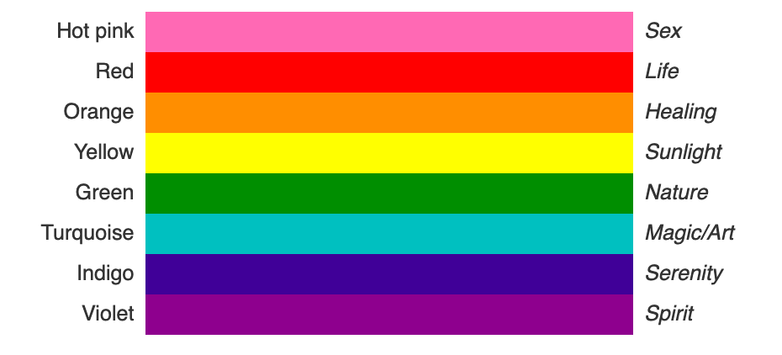
Back to game board

Slide 30
Winner!

